Slide 1
Recommending Locations for A New Restaurant using Spatial Analytics

Slide 2
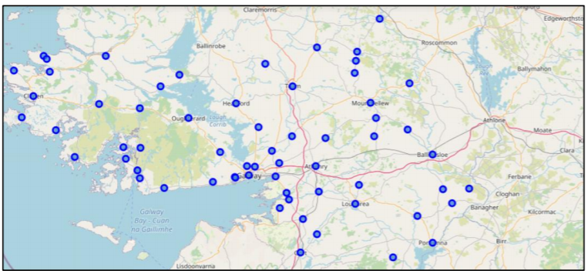
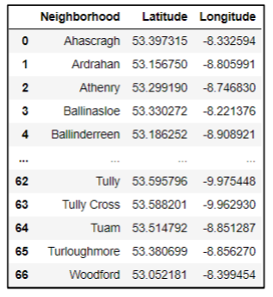
Exploring Neighborhoods in Co. Galway USING GEOPY

Slide 3
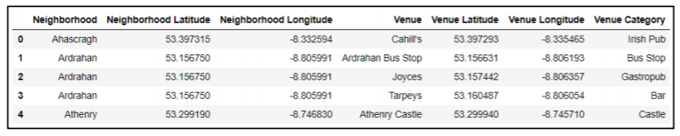
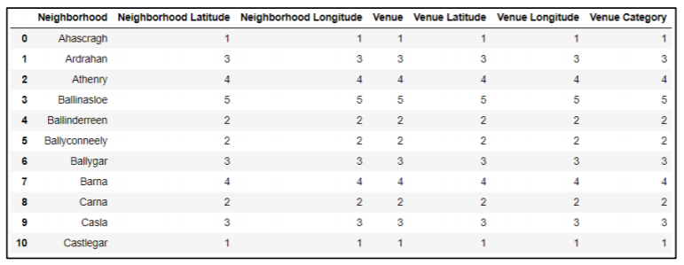
EXPLORING VENUES IN Co. Galway using Foursquare API

Slide 4
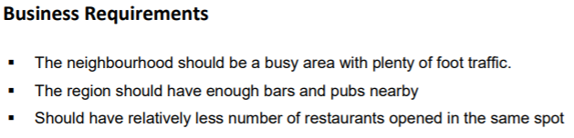
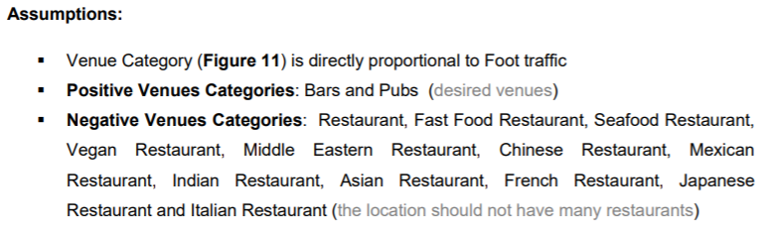

Slide 5
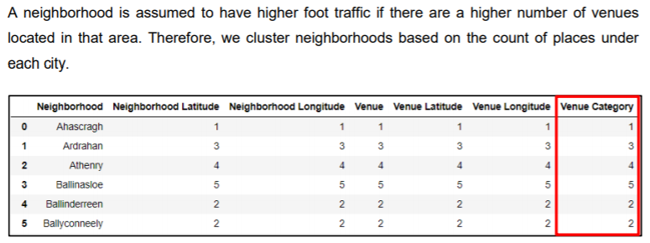
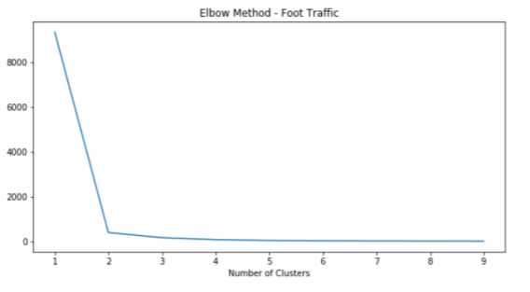
K-MEANS CLUSTERING – Foot Traffic

Slide 6
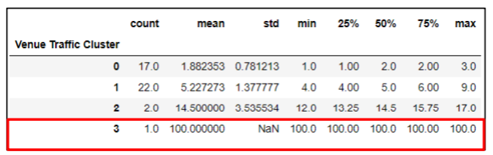
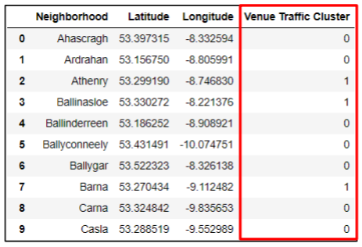
CONTD..
Cluster 3 is the most desirable as neighborhoods under this cluster has an average of 100 venues (mean=100), whereas, Cluster 1 is the least desirable cluster with locations having almost two venues

Slide 7
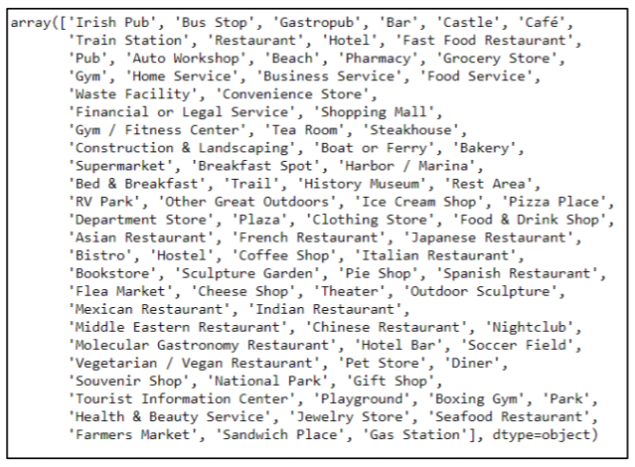
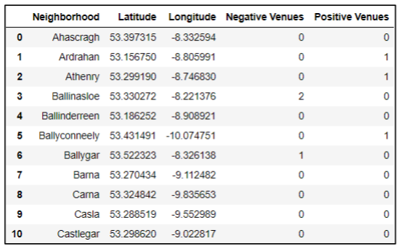
COUNT Of positive and Negative Venues

Slide 8
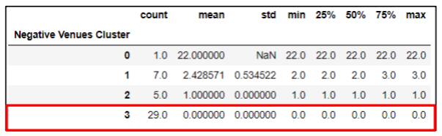
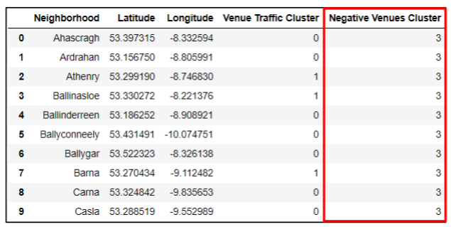
K-MEANS Clustering – Negative Venues
Cluster 3 is most desirable as it comprises of locations that have no restaurants (mean=0), whereas, Cluster 1 is not profitable as it includes sites that have nearly 22 restaurants on an average

Slide 9
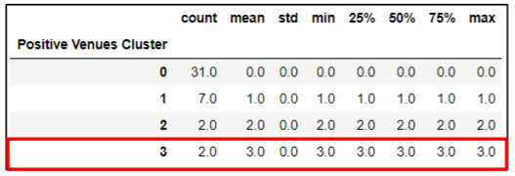
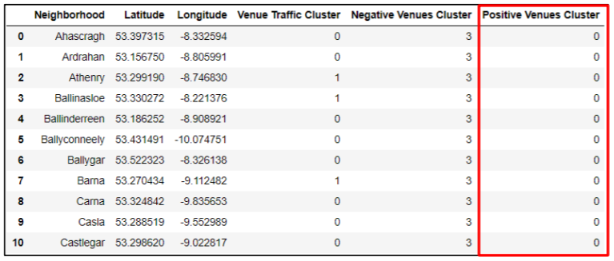
K-MEANS CLUSTERING - FAVORABLE VENUES
Cluster 3 is most desirable as it comprises of locations that have the maximum number of favorable venues like pubs and bars, whereas, Cluster 0 has locations with no promising sites (mean=0)

Slide 10
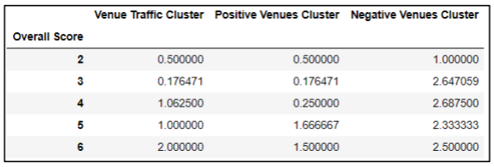
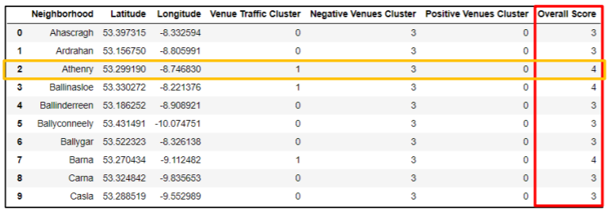
OVERALL SCORING

Slide 11
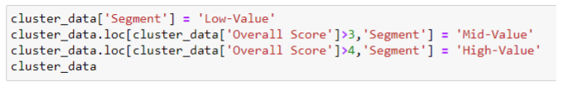
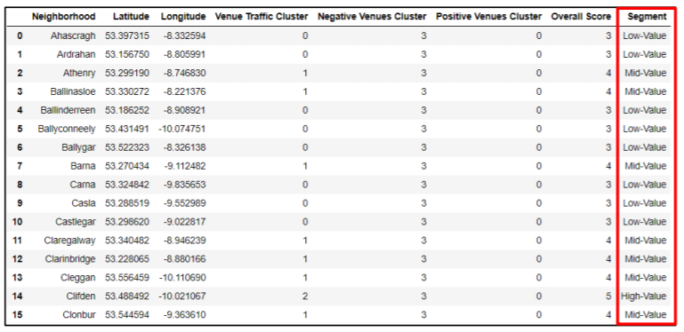
Segmentation

Slide 12
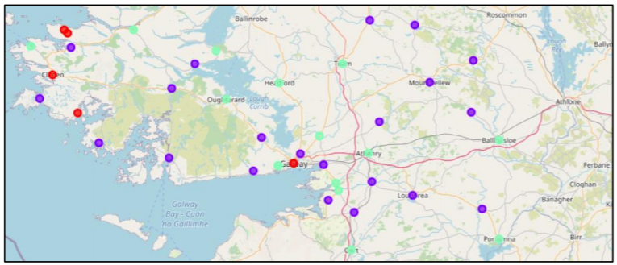
OUTPUT

Slide 13
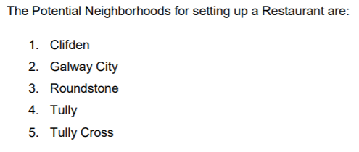
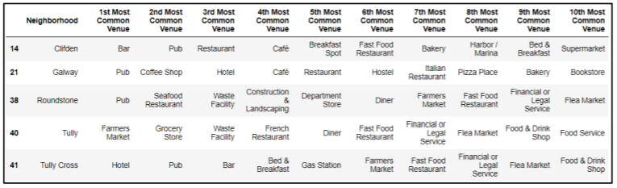
POTENTIAL NEIGHBORHOODS FOR STARTING RESTAURANTS

Slide 14
THANK YOU

